Slide 1

Advanced Hydrology (610 A)
HYDROLOGICAL MODELLING OF KARATHODU CATCHMENT
INDIAN INSTITUTE OF TECHNOLOGY,
KANPUR
Submitted By
Gopal Rai
Ajit Srivastava
Ashish Meena
Submitted To
Dr. Tushar Apurv

Slide 2
Outline
Introduction
Catchment Properties
Hydrologic signatures
Modeling using SUPERFLEX
Plot comparisons
Conclusion
Future scope

Slide 3
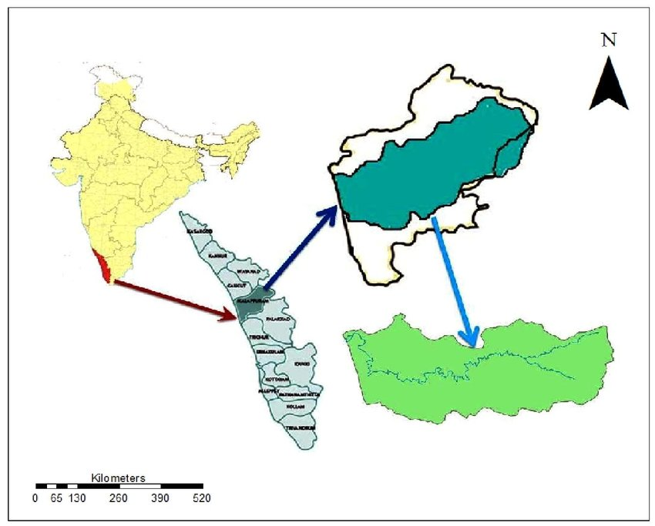
Introduction
Karathodu Catchment is situated near the Kerala coastal at Malappuram district in Kerala
Area - 755 sq.km
Location- 11º05’N,76º04’E
Kadalundi River, Chaliyar River ,and Bharathapuzha River all drain into this catchment
Only the Chaliyar and Bharathapuzha rivers are perennial
Kadalundi River length- 132 km

Slide 4
Catchment Properties
Land use- Land cover
Topography
Soil type
Vegetation
Geology
Climate

Slide 5
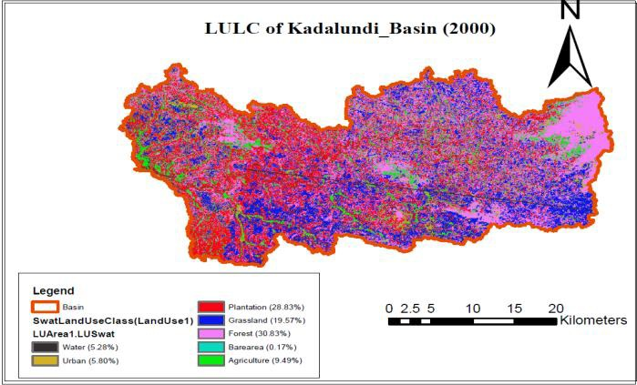
LAND USE /LAND COVER
The main LULC classes include
agriculture
grassland
forest
plantation
water
bare area and
urbanized area

Slide 6
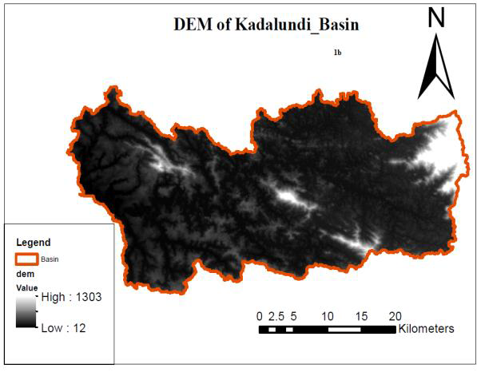
TOPOGRAPHY
The slope of this catchment is from east to west hence the lighter part show the hill area and darkest portion show wet land.
So, the Kadalundi river flow from Western Ghat to Arabian sea.
The catchment contain 15% of hill part, 55% plateau and 30% wetland. This weightage is given in our topographic model also.

Slide 7
SOIL TYPE & VEGETATION
Dominant soils are
Alluvial soil (in the low-land area)
Laterite soil (in the mid-land area)
Forest loamy soil (in the eastern side of Kadalundi Basin)
Apart from this, there is also some amount of clay with high gravel content present in this catchment

Slide 8
GEOLOGY AND CLIMATE
Dry season from December to February and hot season from March to May, the South-West monsoon from June to September and the North-East monsoon from October to December are seen in this catchment.
The normal rainfall of this catchment is 2300 mm.
The South West monsoon is usually very heavy and nearly 70% of the rainfall.
Geomorphologically the catchment can be divided into three viz.
a.) Coastal plain (less than 7.5 m amsl)
b.) Mid land (7.5 – 75 m amsl) and
c.) Highland (above 75 m amsl).

Slide 9
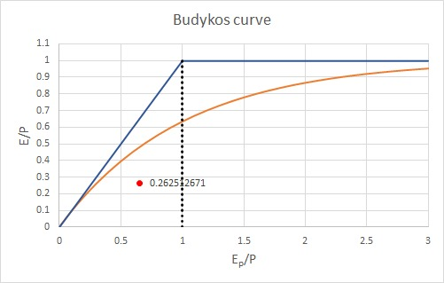

Hydrologic signatures
1. Annual Timescale
Karathodu watershed
Is Energy limited hence
most of the precipitation is converting into the runoff.

Slide 10
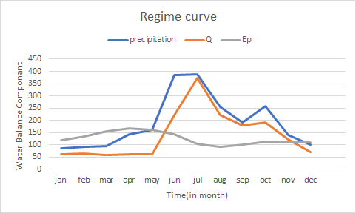
2. Seasonal timescale
From the regime curve, we
can see that the watershed is
Highly seasonal because the
Precipitation is more from JUNE
to SEPTEMBER month.
Also it is Out of Phase watershed.

Slide 11
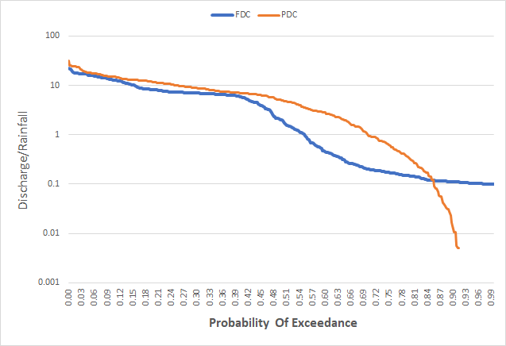
3.Daily timescale
From the FDC curve, we can
see that watershed have steeper
slope FDCs because it is a Arid
catchments and this is due to
lower Baseflow contribution.

Slide 12
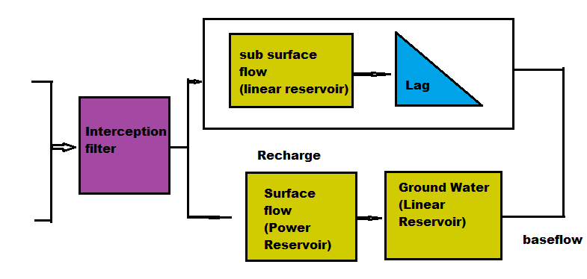
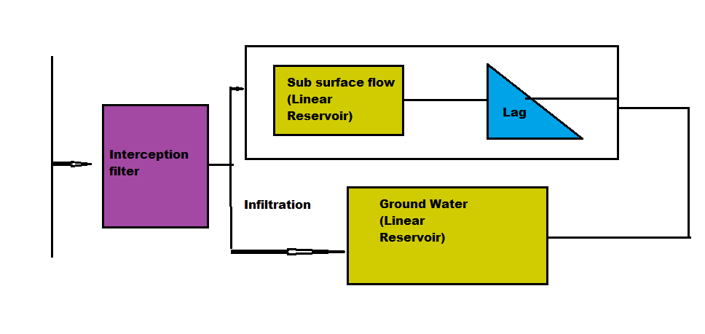
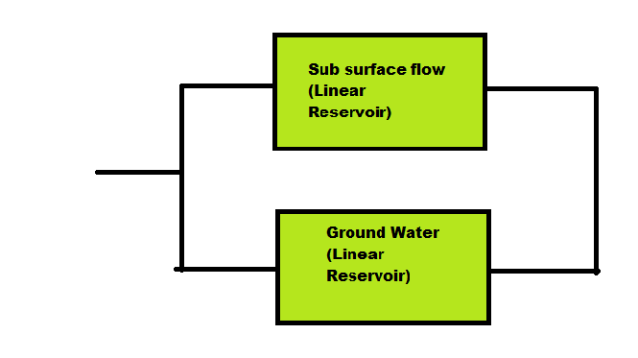
Model based on topography
Precipitation
Hill Slope
Plateau
Wetland
W=5%
EPT
Precipitation
W=60%
q
(catchment)
q
(catchment)
EPT
W=35%
Precipitation

Slide 13
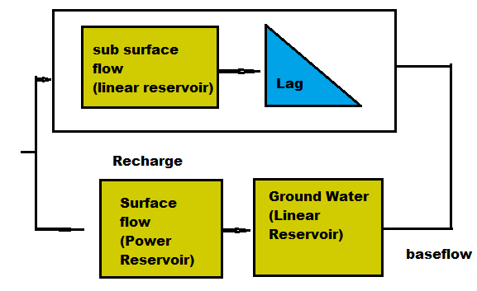
Model based on landuse
Hill Slope
Plateau
Wetland
Precipitation
Precipitation
q
(catchment)
q
(catchment)
EPT
Precipitation

Slide 14
Nash-Sutcliffe coefficient
For Topography model NSC=0.421
For landuse based model NSC=0.023

Slide 15
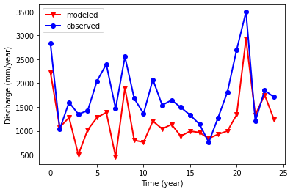
FLow comparison on yearly timescale

Slide 16
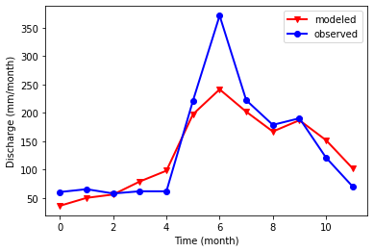
Flow comparison on Monthly timescale

Slide 17
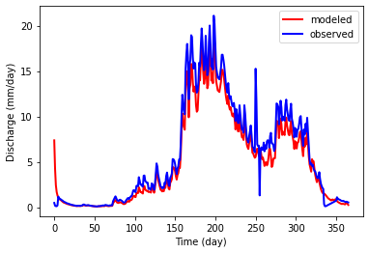
Flow comparison on daily timescale

Slide 18
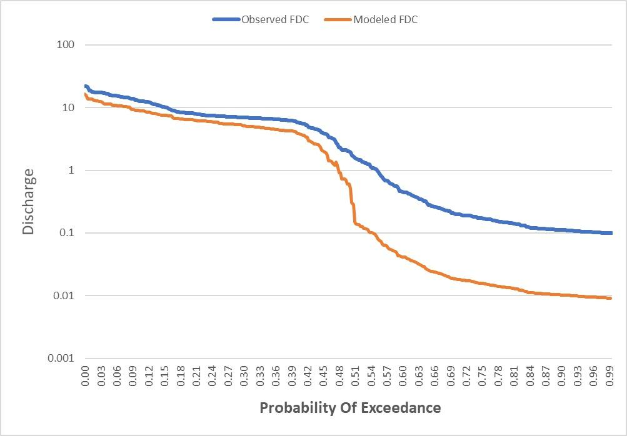
Flow Duration Curve
Comparison from the model and
the given data

Slide 19
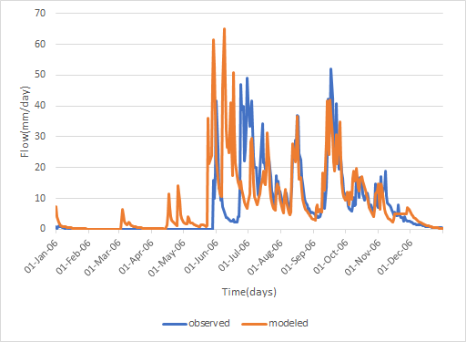
Observed and Modelled flow time-series for a flood event from the record

Slide 20
Conclusion
→From the nash-sutcliffe coefficient , we can observe that the model based on topography shows the best result.
→The parameters and the weights distribution might be the reason for its good performance.
→Surface and sub-surface flow are dominant hydrologic process contributing to streamflow.
→Surface and sub-surface flow is more because of the energy-limited and the catchment have most of the area covered from plantation and the grassland which was shown in topography map.

Slide 21
Future Scope
→We have 25 years of data, but catchment properties like soil,vegetation can be changed so we have to consider it for modeling according to time.
→From FDC comparison of the model and observed data, it shows that the modeled FDC is showing under predicted baseflow.
→Land use /land cover can be change or agricultural land may be more in future. So change detection must be deliberated for better results.

Slide 22
REFERENCES
ASSESSING IMPACTS OF LANDUSE/LANDCOVER CHANGE ON SURFACE RUNOFF FOR KADALUNDI RIVER BASIN: A WATERSHED MODELING APPROACH (Sinha R. K., Eldho T. I., Ghosh S.).
IDENTIFICATION OF GROUNDWATER POTENTIAL ZONES USING GEOPHYSICAL TECHNIQUE IN KADALUNDI RIVER BASIN, MALAPPURAM, KERALA (S. Sajeena, E. K. Kurien, V. K. Brijesh)
GROUND WATER INFORMATION BOOKLET OF MALAPPURAM DISTRICT, KERALA STATE
DISTRICT SURVEY REPORT OF MINOR MINERALS, MALAPPURAM DISTRICT, KERALA

